Slide 1


AI-Enhanced WordPress Plugin

Slide 2


AI – Enhanced
Output
Decision making
Teamwork
Stakeholder engagement
Reflection

Slide 3

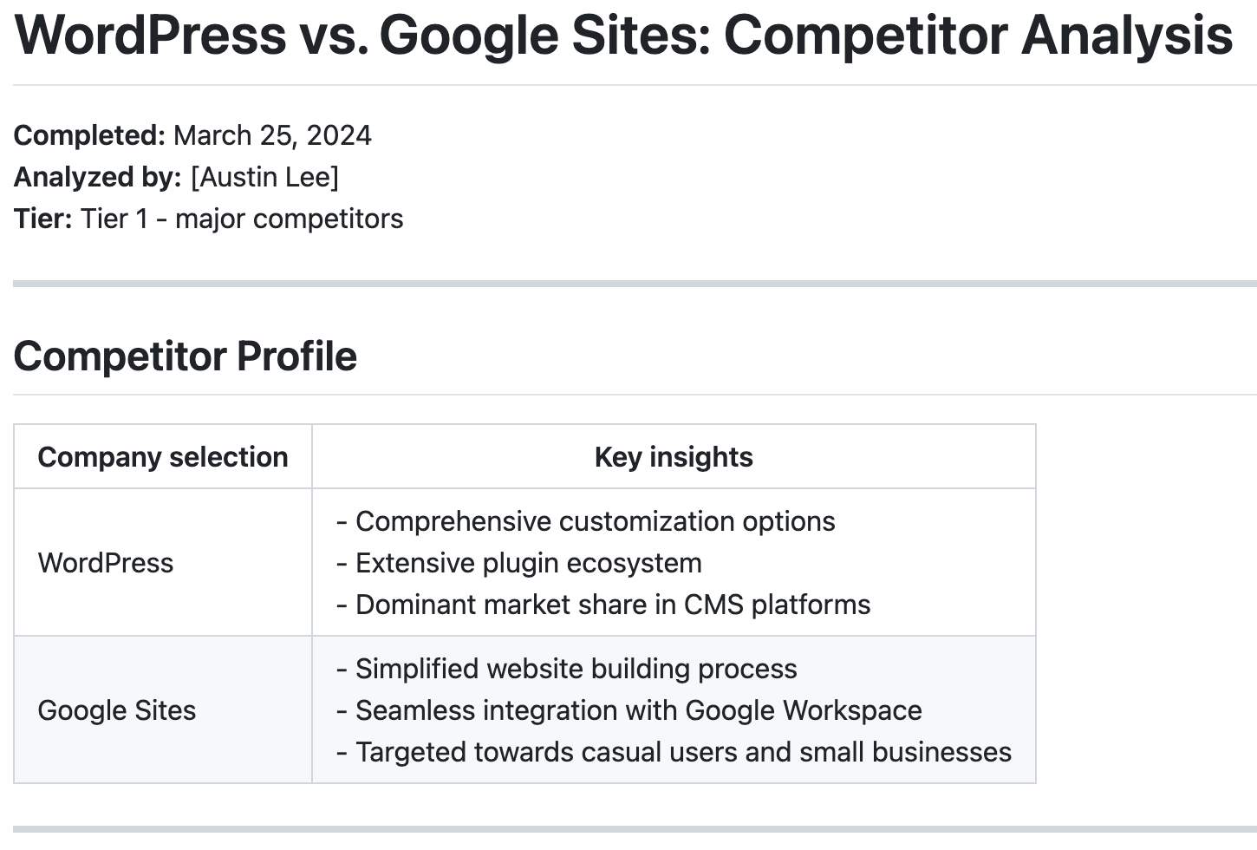



AI-Enhanced
Elevator Picth
In a digital world, every second and every user interaction counts
Powered by React JS, enhanced by AI
Limitless design meets user-centric flexibility
Step beyond Google Sites into boundless creativity and efficiency
Notes:
Vs Google site

Slide 4
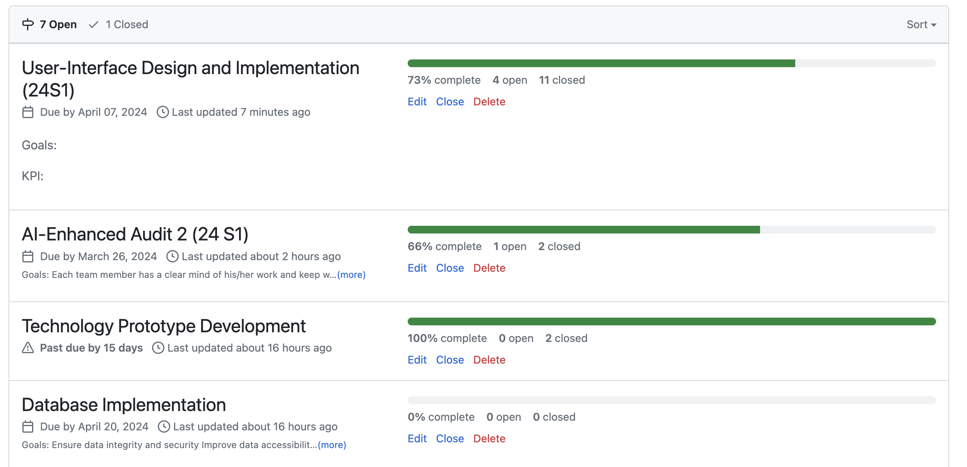
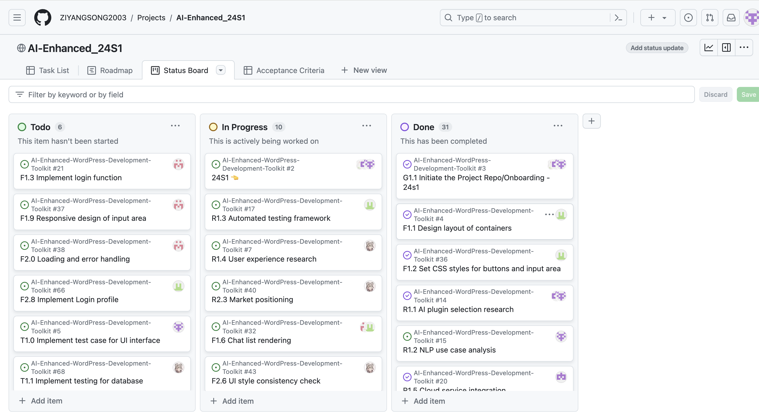
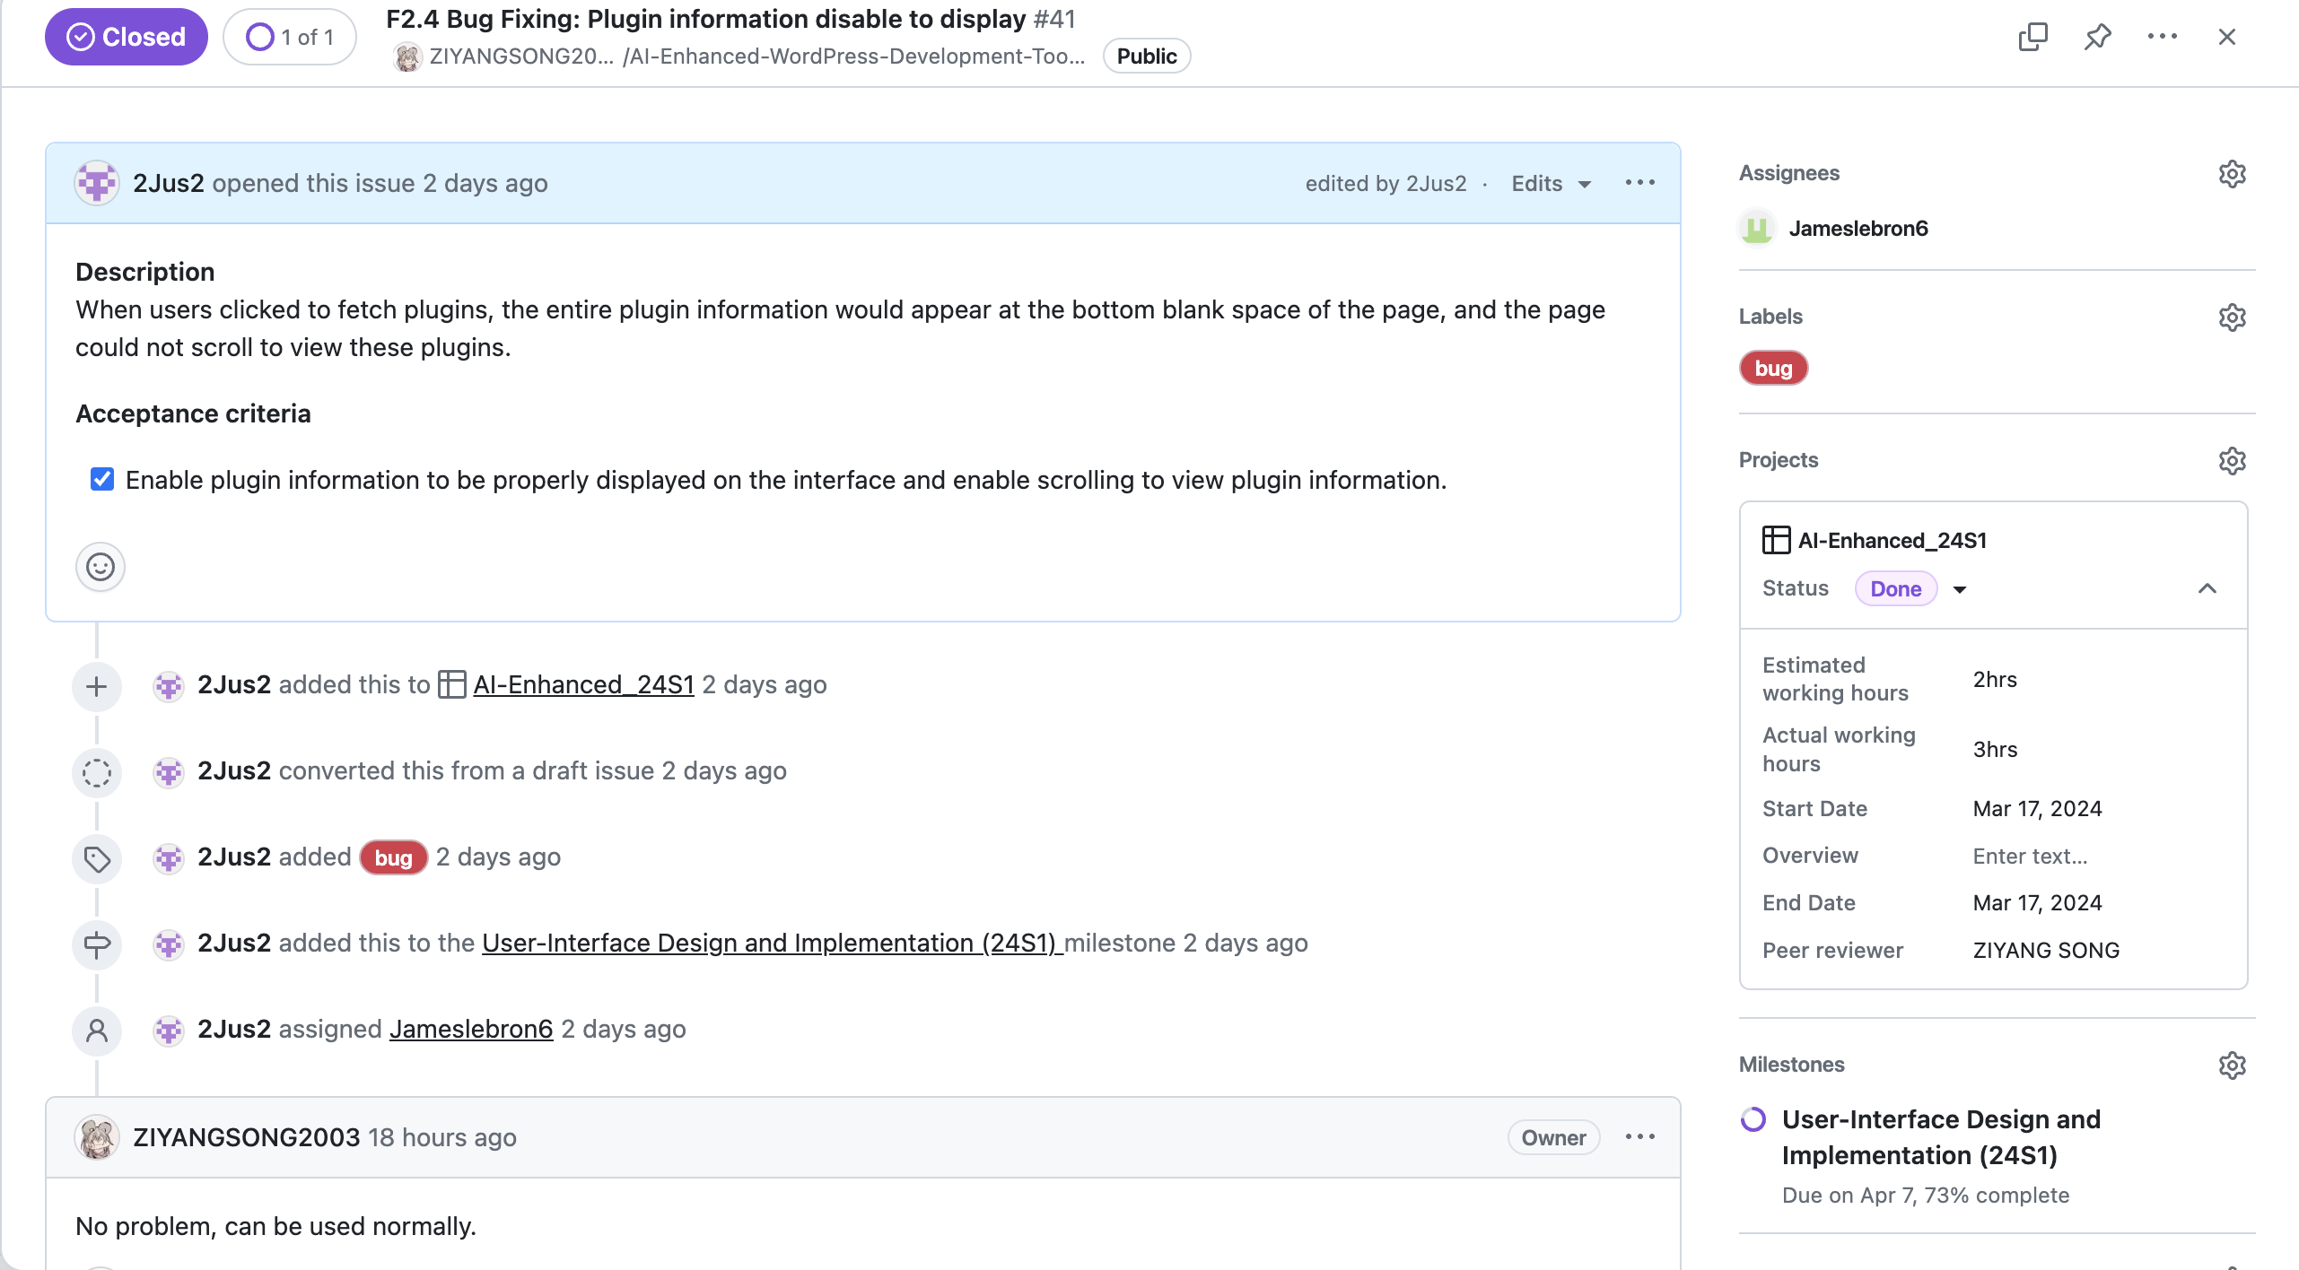
Output
Milestone
Ticketing system

Slide 5
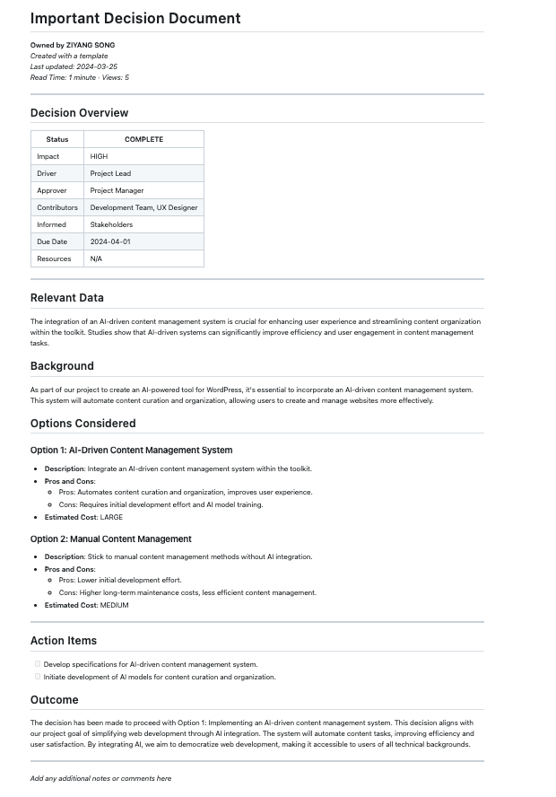
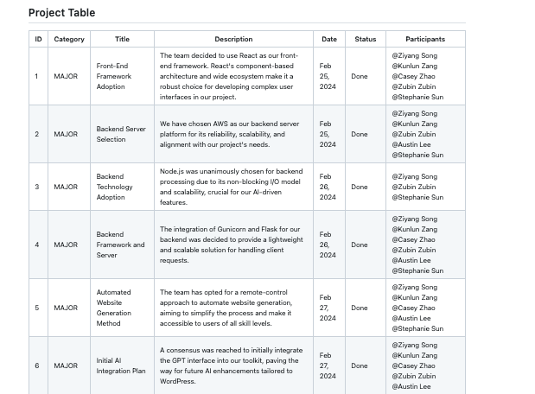
Decision making

Slide 6


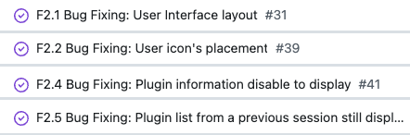
User-Interface Implementation
Requires to implement
user-interface
Discuss which framework should be used: Python, vue and React
I would vote for Python; cause we all know how to program in Python
I would vote for React, cause React is the most popular choices for build front-end interfaces and its easy to learn
After comparison and research, we decide to use React
Weekly Team meeting
Record in decision log
Front-end team would openly discuss about theses issue during meeting
Feasibility
Approach to resolve
3) requires extra help or not
Research & Test
Implementation stage (Bug raised)
Record in decision log

Slide 7
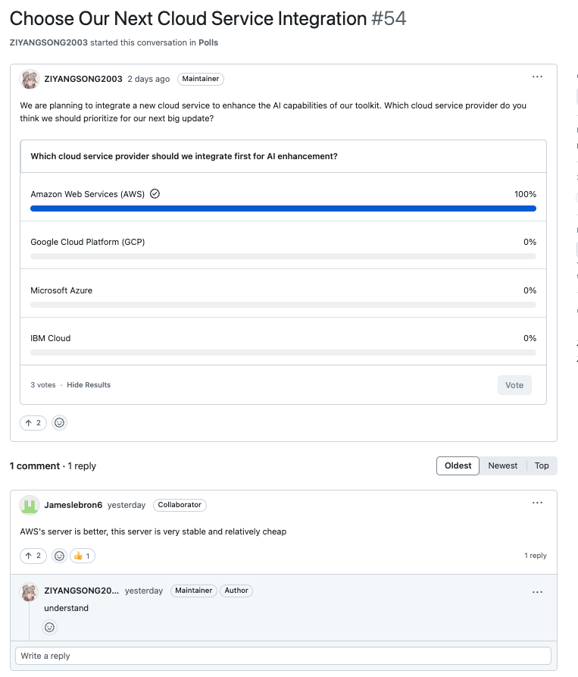
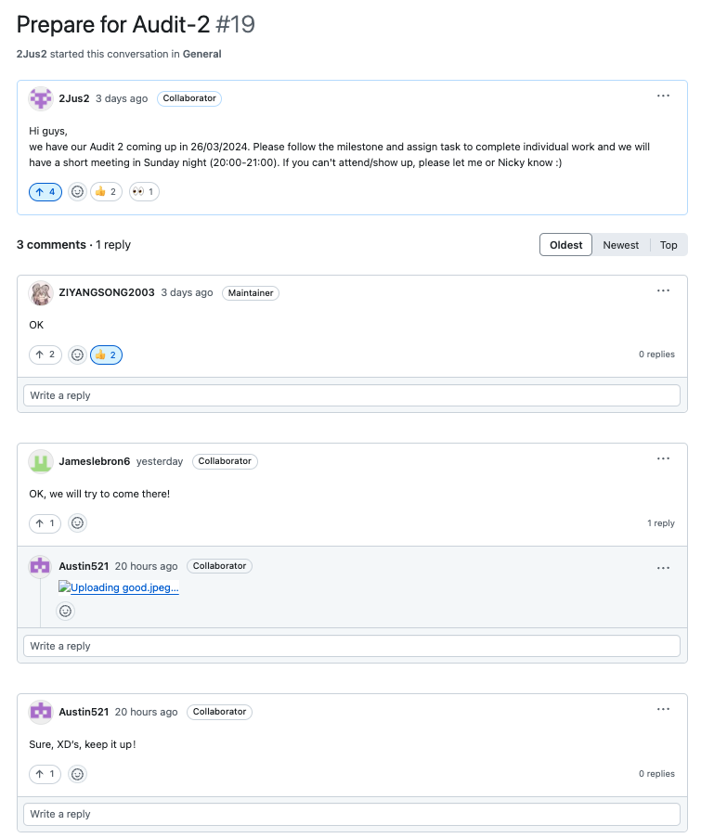
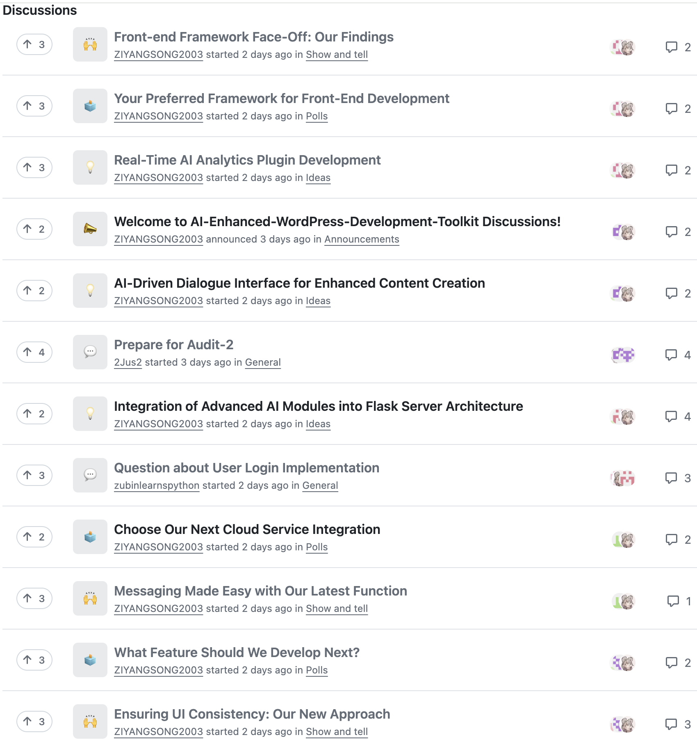
Teamwork
Vote
General
Discussions

Slide 8
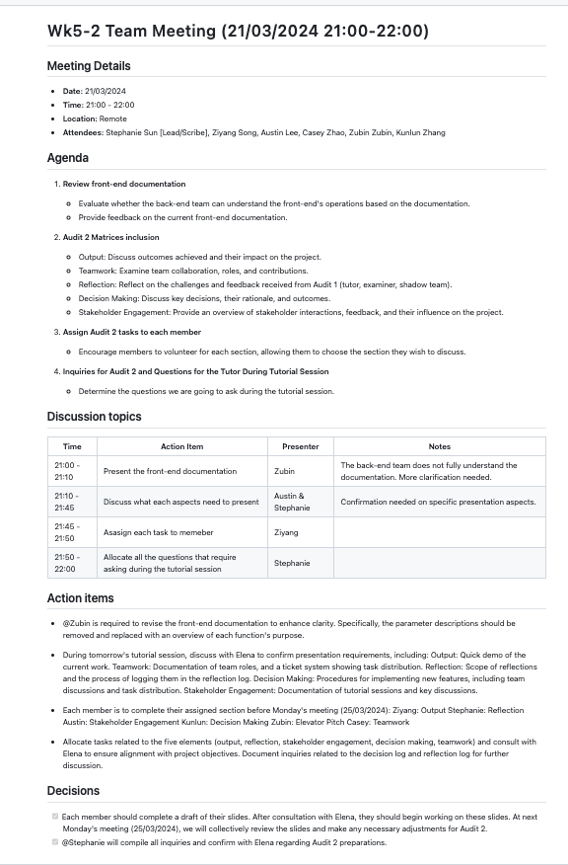
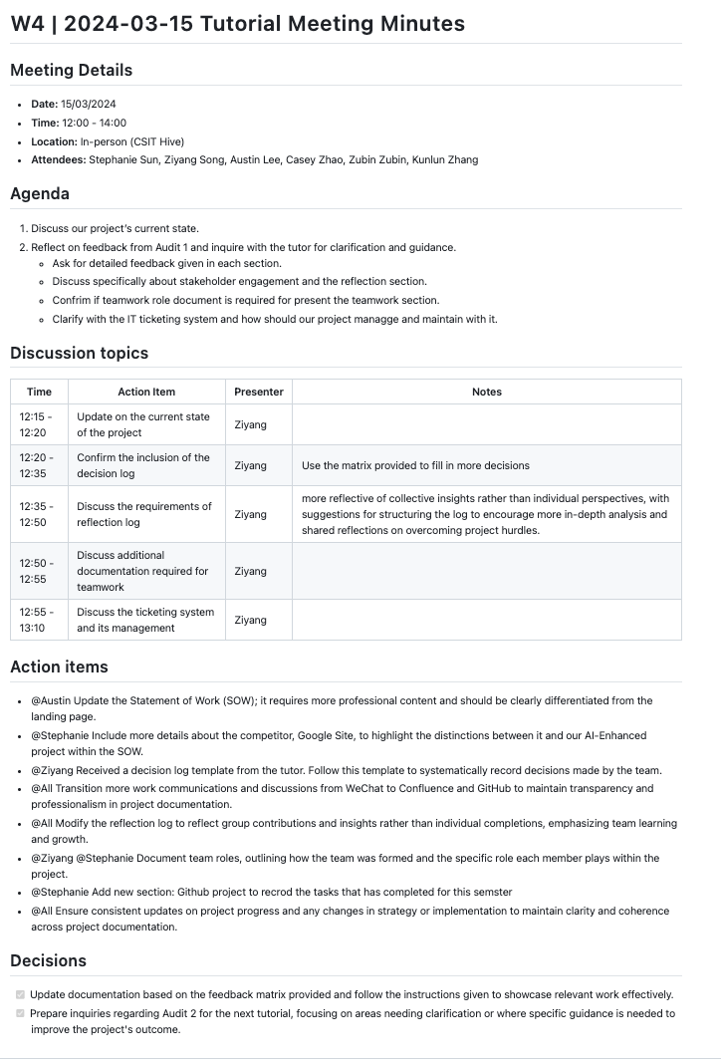
Stakeholder engagement
Weekly meeting: Monday 15:00 – 16:00
Tutorial meeting (Stakeholder) : Friday 12:00 – 14:00

Slide 9
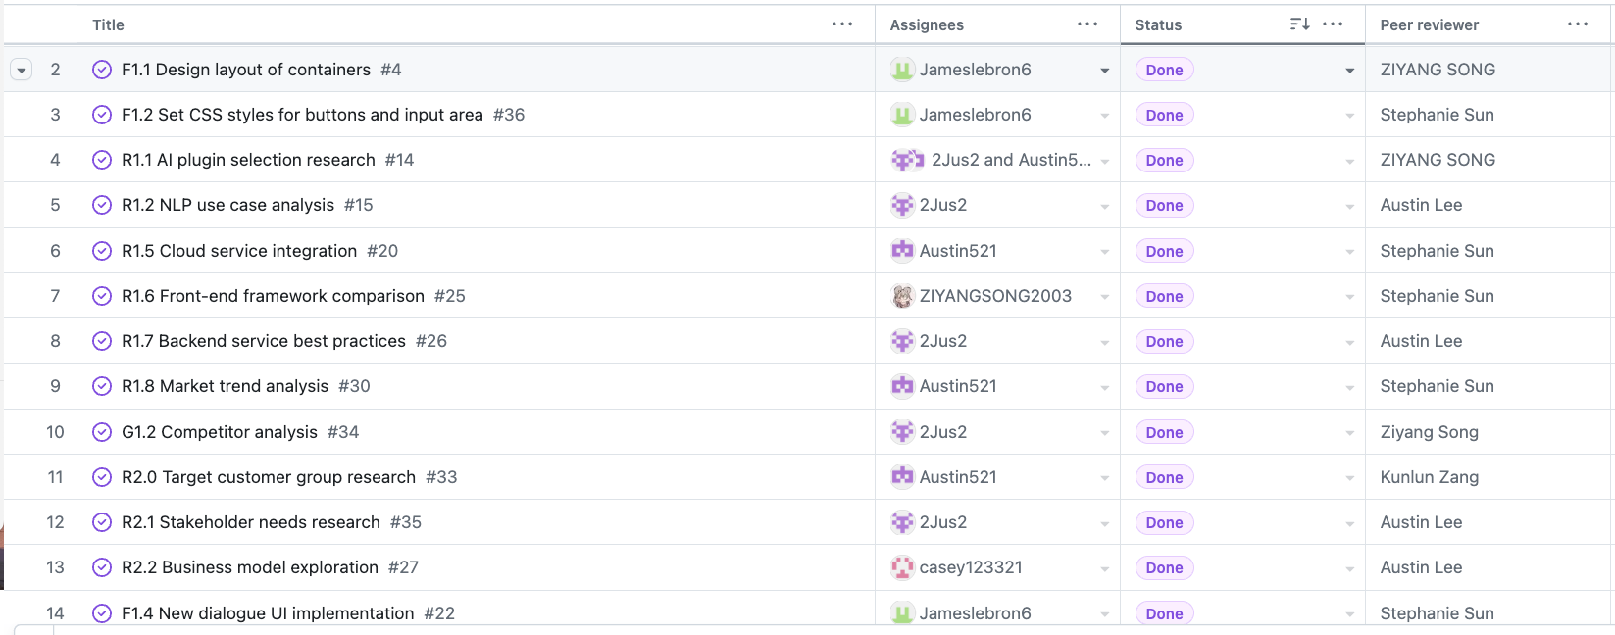
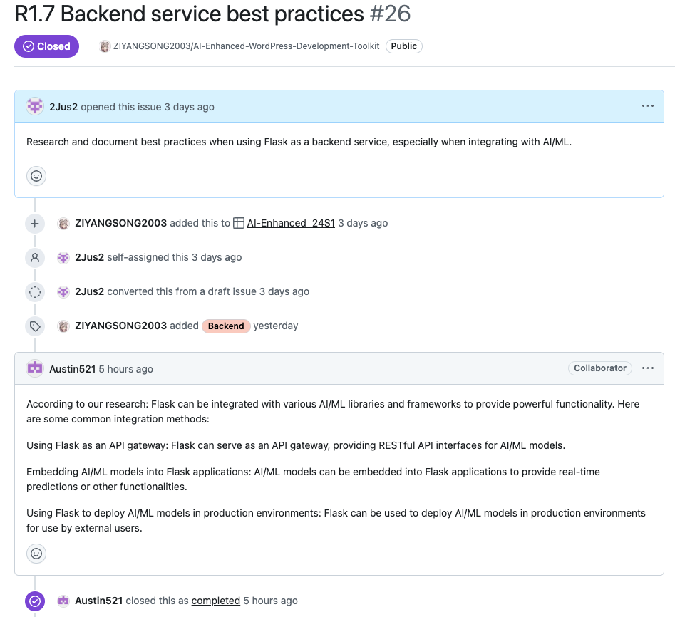
Reflection
Feedback Mechanism – Case 1: Peer review

Slide 10
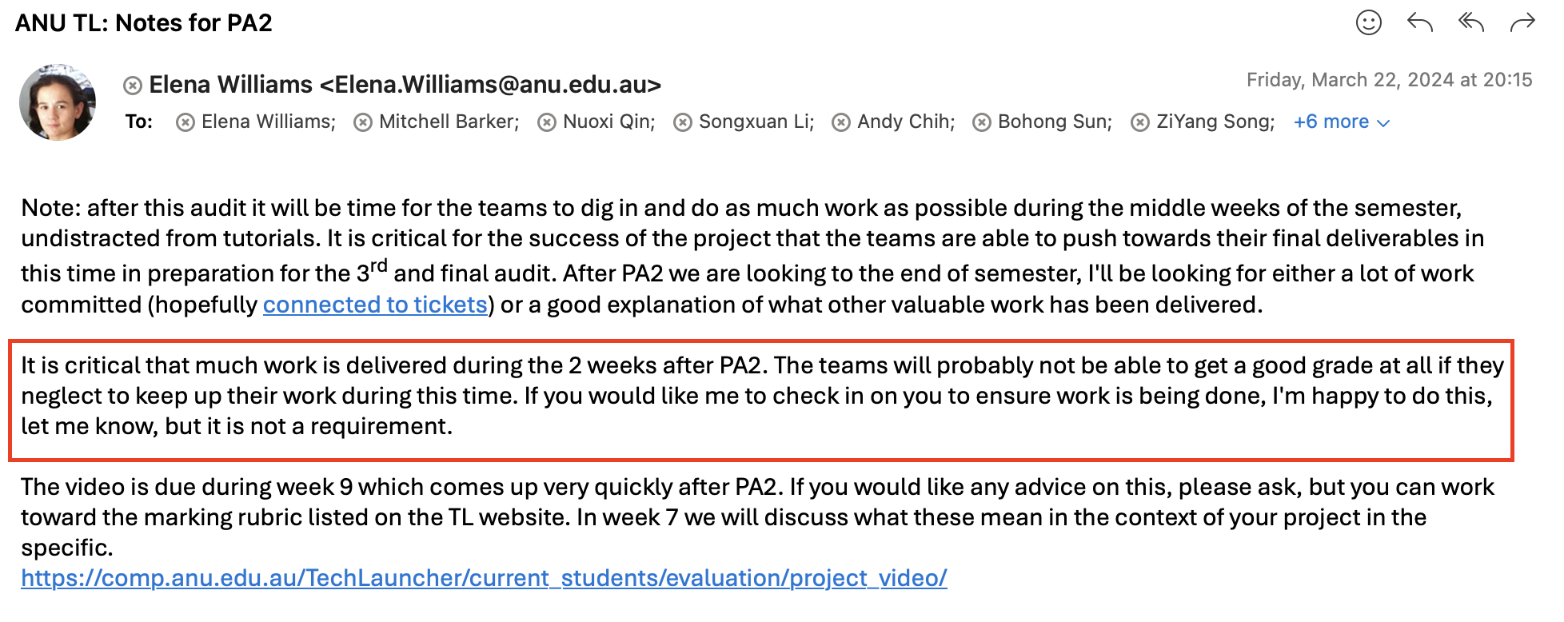
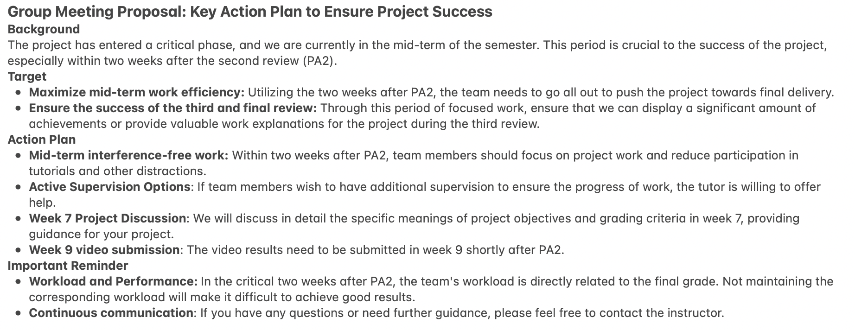
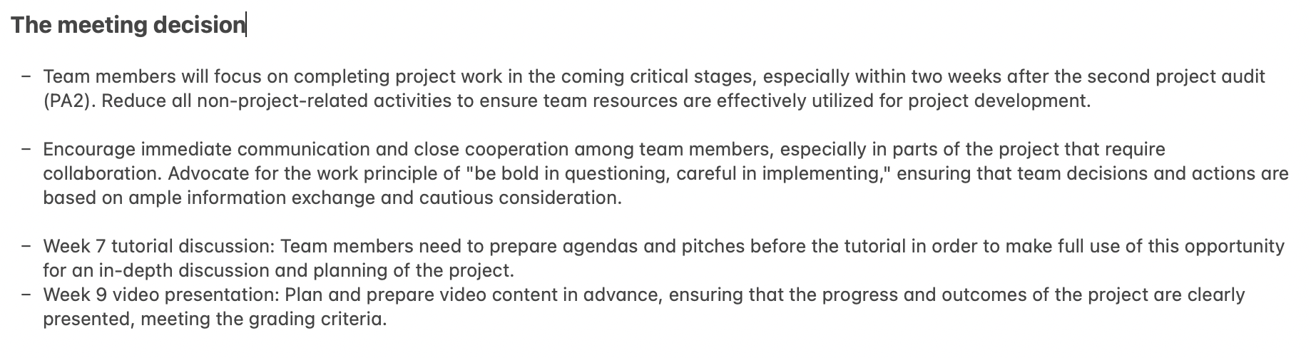
Feedback Mechanism – Case 2: Stakeholder feedback
Received feedback from stakeholder
The team spokesperson allocate the feedbacks.
Place the feedbacks as one of the agenda task for discussion during the team meeting.
After discussion, it’s been settled how should we modify/update with the current work

Slide 11
User – Interface implementation
Feedback
08/03
Audit 1
Accept feedback from Liang, Elena, and initiate the internal feedback mechanism.
Bug resolved
13/03
Front-end team fixes the display bug in the interface
Front-end interface demo
Code peer review
18/03
Front-end members peer review
The basic functions of the front-end interface can run normally.
24/03
The team leader decides whether to adopt the code and completes the merging of branches.
The front end receives information that can be uploaded to the back end located on the cloud service platform.
26/03
Audit 2

Slide 12
Q & A

